Slide 1
Predictive Modeling
Chapter 6: Linear Regression and Its Cousins
STA 6543
The University of Texas at San Antonio

Slide 2
Overview
Part I: General Strategies
Part II: Regression Models
Chapter 6: Linear Regression and Its Cousins
Chapter 7: Nonlinear Regression Models
Chapter 8: Regression Trees and Rule-Based Models
Part III: Classification Models
Chapter 12: Discriminant Analysis and Other Linear Classification Models
Chapter 13: Nonlinear Classification Models
Chapter 14: Classification Trees and Rule-Based Models

Slide 3
Linear Regression and Its Cousins
A motivating example about solubility data
Linear regression
Principal component regression(PCR)
Partial least squares (PLS)
Penalized regression models
Ridge regression
Lasso
Elastic net (ENET)
R demonstrations

Slide 4
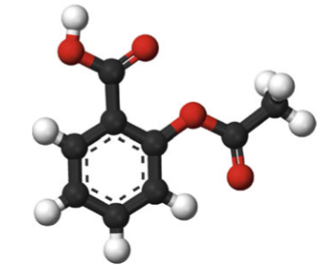
A motivating example about solubility data
A representation of aspirin, which contains carbon atoms (black balls) and hydrogen (white) and oxygen atoms (red)

Slide 5
A motivating example about solubility data
We collect several quantitative measurements, called as chemical descriptors.
We may obtain many characteristics of molecules empirically using experiments.
The data set consists of 1267 compounds and a set of more understandable descriptors that fall into one of three groups:
Two hundred and eight binary (208) “ﬁngerprints” that indicate the presence or absence of a particular chemical substructure.
Sixteen count descriptors (16), such as the number of bonds or the number of bromine atoms.
Four continuous descriptors (4), such as molecular weight or surface area.

Slide 6
A motivating example about solubility data
Researchers are interested in investigating a set of compounds with corresponding experimental solubility values using complex sets of descriptors.
They used linear regression (parametric model) and neural network (nonparametric model) models to estimate the relationship between chemical structures (predictors) and solubility (response).

Slide 7
A motivating example about solubility data
Here are a few important questions that we might seek to address:
Do we need to pre-process the data? (i.e., skewness, near-zero variance predictors, significant between-predictor correlations, etc)
How do we split the data into a training and a test set. (random sampling, stratified random sampling)?
How do we fit some parametric models (i.e., linear regression models, partial least squares, penalized models).
Which model has the best predictive ability? Is any model significantly better or worse than the others?

Slide 8
Data Pre-processing
8

Slide 9
Data pre-processing
#Required packages library(AppliedPredictiveModeling) library(lattice) library(caret) library(corrplot) library(e1071) library(pls) library(elasticnet) #Access the solubility data data(solubility) plot(solTrainY ~ solTrainX$MolWeight, ylab = "Solubility (log)", main = "(a)", col='blue', xlab = "Molecular Weight") fit = lm(solTrainY ~ solTrainX$MolWeight) abline(fit, col=2, lwd=2) #correlation test cor.test(solTrainY,solTrainX$MolWeight)

Slide 10
Correlations between descriptors
Correlations between Molecular Weight and Solubility(log)

Slide 11
Correlation test between descriptors
> cor.test(solTrainY, solTrainX$MolWeight) Pearson's product-moment correlation data: solTrainY and solTrainX$MolWeight t = -24.936, df = 949, p-value < 2.2e-16 alternative hypothesis: true correlation is not equal to 0 95 percent confidence interval: -0.6660933 -0.5891573 sample estimates: cor -0.6291639 >

Slide 12
Scatter plot
xyplot(solTrainY ~ solTrainX$NumRotBonds, type = c("p", "g"), ylab = "Solubility (log)", xlab = "Number of Rotatable Bonds") #The function bwplot() makes box-and-whisker plots for numerical variables bwplot(solTrainY ~ ifelse(solTrainX[,100] == 1, "structure present", "structure absent"), ylab = "Solubility (log)", main = "(b)", horizontal = FALSE)

Slide 13
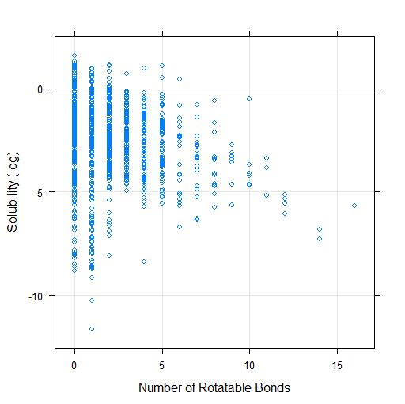
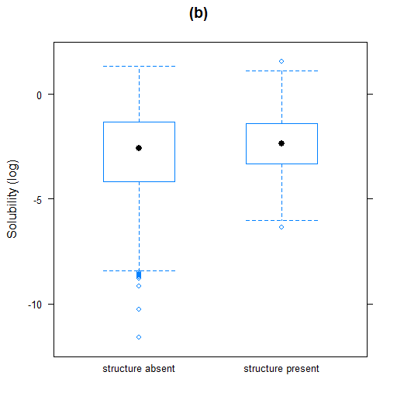
Scatter plot

Slide 14
Correlations between descriptors
The above examples showed that there are strong correlations among predictors, so how do we deal with significant correlations between the quantitative predictors?
Key step: Find the columns that are not fingerprints (FP) (i.e. numerical predictors). The R function grep will return a list of integers corresponding to column names that contain the pattern "FP".
Idea: Use the R function featurePlot to produce lattice graphs or use the R function corrplot to get a graphical display of a correlation matrix

Slide 15
Correlations between descriptors
### Find the columns that are not fingerprints (i.e. numerical ### predictors). grep will return a list of integers corresponding to ### column names that contain the pattern "FP". notFingerprints <- grep("FP", names(solTrainXtrans)) library(caret) featurePlot(solTrainXtrans[, -notFingerprints], solTrainY, between = list(x = 1, y = 1), type = c("g", "p", "smooth"), labels = rep("", 2)) library(corrplot) corrplot::corrplot(cor(solTrainXtrans[, -notFingerprints]), order = "hclust", tl.cex = .8)

Slide 16
Correlations between descriptors

Slide 17
Correlations between descriptors

Slide 18
Correlations between descriptors
#Remove high correlated predictors (cor>0.9) tooHigh <- findCorrelation(cor(solTrainXtrans[, -notFingerprints]), .9) corrplot::corrplot(cor(solTrainXtrans[, -notFingerprints][,-tooHigh]), order = "hclust", tl.cex = .8)

Slide 19
Correlations between descriptors

Slide 20
Near zero variance predictors
#Remove near zero variance predictors > # Remove near zero variance predictors > nearZeroVar(solTrainXtrans) [1] 154 199 200

Slide 21
Skewness and Box-Cox transformation
#Skewness library(e1071) apply(solTrainXtrans[, -notFingerprints], 2, skewness) #Box-Cox transformation library(caret) Original = as.matrix(solTrainXtrans[, -notFingerprints]) solTrainXtransBoxCox = BoxCoxTrans(Original) solTrainXtransBoxCox

Slide 22
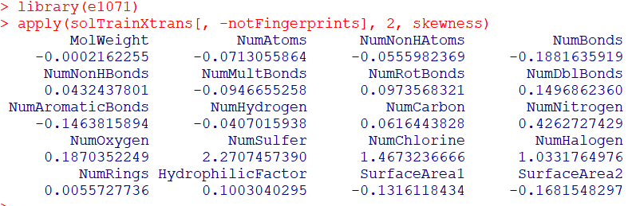
Skewness

Slide 23
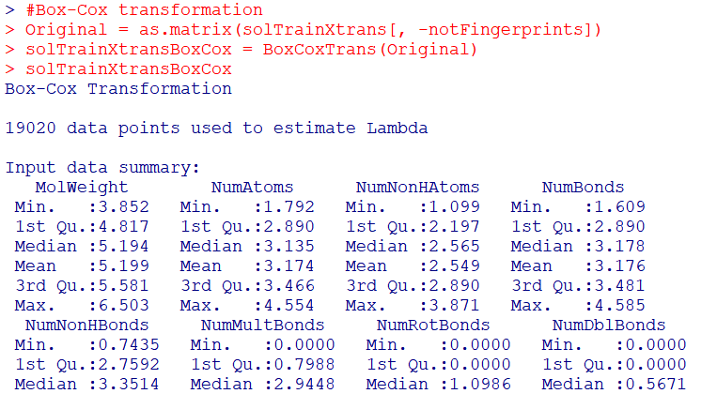
Box-Cox transformation

Slide 24
Model building
Linear Regression

Slide 25
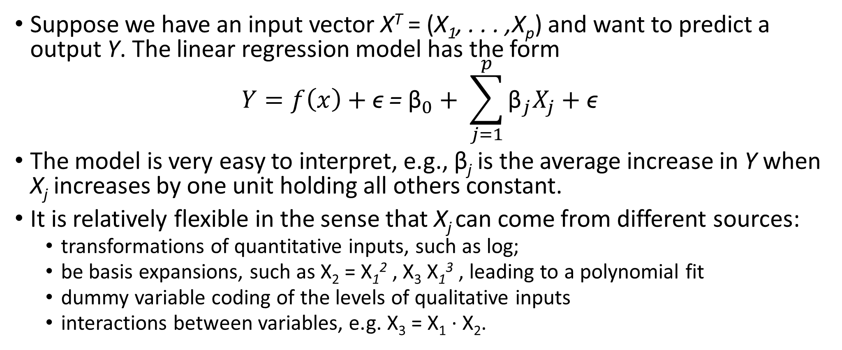
Linear regression models
Suppose we have an input vector X^{T} = (X₁, . . . ,X_{p}) and want to predict a output Y. The linear regression model has the form
$$Y=f\left(x\right)+\text{ϵ}\text{ = }{\text{β}}_{0}+ \sum_{j=1}^{p}{{\text{β}}_{j}X_{j}}+\text{ϵ}$$
The model is very easy to interpret, e.g., $\text{β}$_{j} is the average increase in Y when X_{j} increases by one unit holding all others constant.
It is relatively flexible in the sense that X_{j} can come from different sources:
transformations of quantitative inputs, such as log;
be basis expansions, such as X₂ = X₁² , X₃ X₁³ , leading to a polynomial fit
dummy variable coding of the levels of qualitative inputs
interactions between variables, e.g. X₃ = X₁ · X₂.

Slide 26
Linear regression model in a matrix form

Slide 27
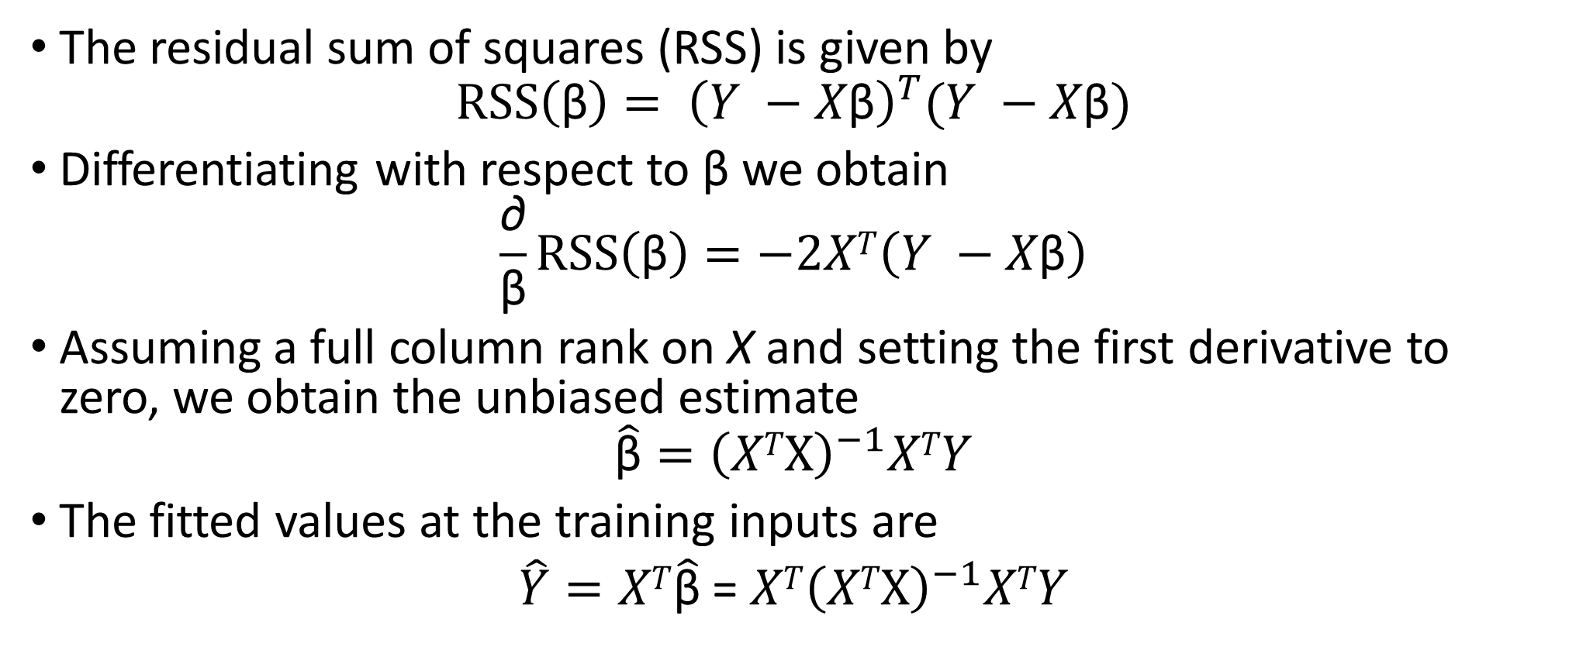
Ordinary least squares estimates (OLS)
The residual sum of squares (RSS) is given by
$$RSS\left(\text{β}\right)= {\left(Y −X\text{β}\right)}^{T}(Y −X\text{β})$$
Differentiating with respect to β we obtain
$$\frac{\text{∂}}{\text{β}}RSS\left(\text{β}\right)=−2XT\left(Y −X\text{β}\right)$$
Assuming a full column rank on X and setting the first derivative to zero, we obtain the unbiased estimate
$$\hat{\text{β}}={\left(XT\text{X}\right)}^{−1}XTY$$
The fitted values at the training inputs are
$\hat{Y}=XT\hat{\text{β}}$ = ${XT\left(XT\text{X}\right)}^{−1}XTY$
OLS

Slide 28
Measures of fit: R² Statistic
Some of the variation in Y can be explained by variation in the X’s and some cannot.
R² tells you the fraction of variance that can be explained by X.
R² is always between 0 and 1. Zero means no variance has been explained. One means it has all been explained (perfect fit to the data).
However, it can still be challenging to determine what is a good R² values, and in general, this will depend on the application.

Slide 29
Remarks on OLS
Easy to compute and interpretable

Slide 30
Potential problems
When we fit a linear regression model to a particular data set, many problems may occur. Most common among these are the following:
The number of predictors p larger than the sample size n.
Collinearity.
Non-linearity of the response-predictor relationships.
Correlation of error terms.
Non-constant variance of error terms.
Outliers.
High-leverage points.
……

Slide 31
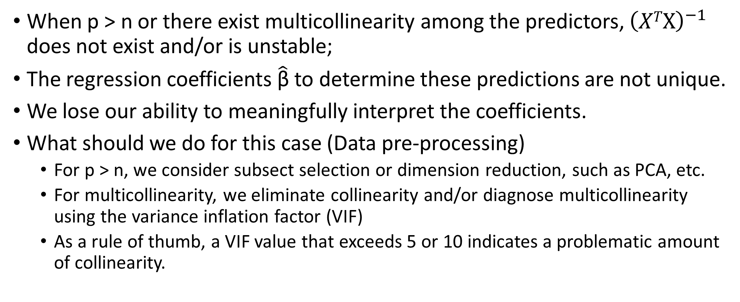
p > n and/or collinearity
When p > n or there exist multicollinearity among the predictors, ${\left(XT\text{X}\right)}^{−1}$ does not exist and/or is unstable;
The regression coefficients $\hat{\text{β}}$to determine these predictions are not unique.
We lose our ability to meaningfully interpret the coefficients.
What should we do for this case (Data pre-processing)
For p > n, we consider subsect selection or dimension reduction, such as PCA, etc.
For multicollinearity, we eliminate collinearity and/or diagnose multicollinearity using the variance inflation factor (VIF)
As a rule of thumb, a VIF value that exceeds 5 or 10 indicates a problematic amount of collinearity.

Slide 32
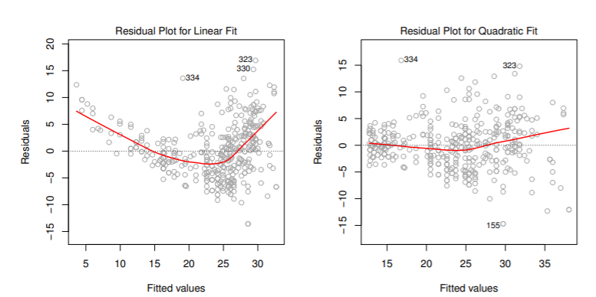
Non-linearity of the data
Based on the residual plots of the two models,
Which model is more linear?

Slide 33
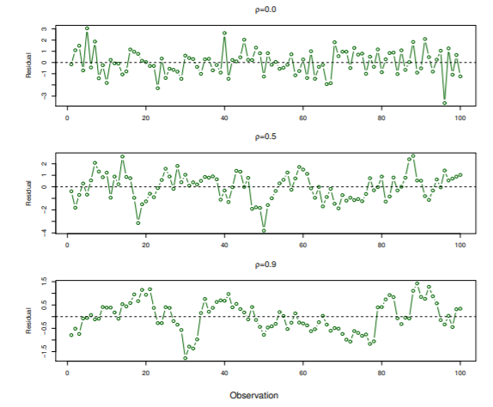
Correlation of error terms
If in fact there is correlation among the error terms, then the estimated standard errors will tend to underestimate the truth

Slide 34
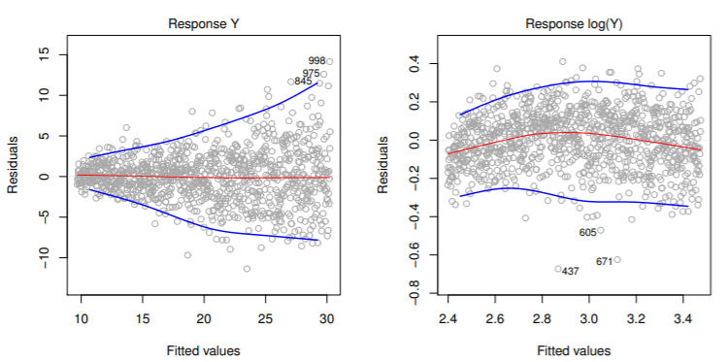
Non-constant variance of error terms
A transformation of the response Y usually helps. Or consider more general methods that support heteroscedastic errors

Slide 35
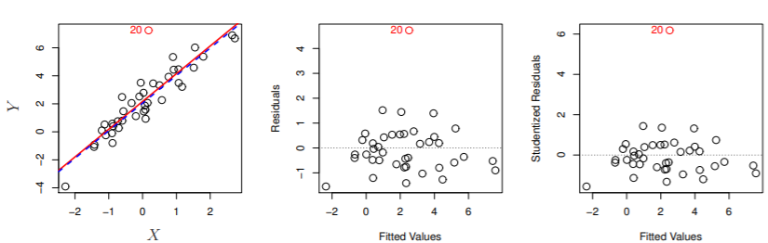
Outliers
Observations whose studentized residuals are greater than 3 in absolute value are possible outliers.

Slide 36
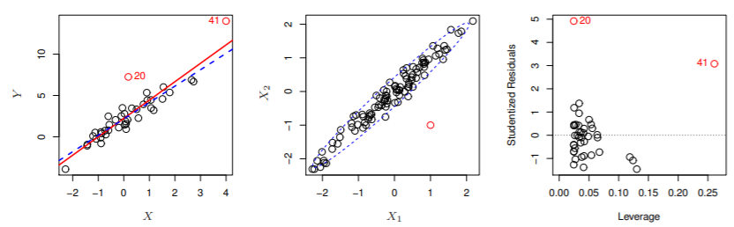
High-leverage points (influential points)
LEFT: Observation 41 is a high leverage point, while 20 is not. The red line is the fit to all the data, and the blue line is the fit with observation 41 removed.
CENTER: High leverage
RIGHT: Observation 41 has a high leverage and a high residual.

Slide 37
Conclusions
These observations motivate to come alternative predictive models that can improve the linear model performance.
There are 2 reasons we might not prefer to just use the ordinary least squares (OLS) estimates: prediction accuracy and model interpretability.

Slide 38
Prediction accuracy
If n >>p, —that is, if n, the number of observations, is much larger than p, the number of variables—then the least squares estimates tend to also have low variance, and hence will perform well on test observations.
But, when n ≈ p, then the least squares fit can have high variance and may result in over fitting and poor estimates on unseen observations
And, when n < p, then there is no longer a unique least squares coefficient estimate: the variance is infinite so the method cannot be used at all

Slide 39
Model interpretability
When we have a large number of predictors X in the model there will generally be many that have little or no effect on Y
Leaving these variables in the model makes it harder to see the “big picture”, i.e., the effect of the “important variables”.
The model would be easier to interpret by removing (i.e. setting the coefficients to zero) the unimportant variables.

Slide 40
Alternatives to least squares
Subset Selection (Chapter 19)
Identifying a subset of all p predictors X that we believe to be related to the response Y, and then fitting the model using this subset
E.g. best subset selection and stepwise selection
Dimension Reduction
Involves projecting all p predictors into an M-dimensional space where M < p, and then fitting linear regression model
E.g. Principal component regression, partial least squares regression
Shrinkage (Penalization)
Involves shrinking the estimates coefficients towards zero
This shrinkage reduces the variance
Some of the coefficients may shrink to exactly zero, and hence shrinkage methods can also perform variable selection
E.g. Lasso or ENET

Slide 41
Model building
Dimension reduction – principal components regression (PCR) and partial least squares (PLS)

Slide 42
Dimension reduction methods
All of these methods are defined using the original p predictors, X₁, . . . , X_{p}.
We explore a class of approaches that transform the predictors and then fit a least squares model using the transformed variables.
We will refer to these techniques as dimension reduction methods.

Slide 43
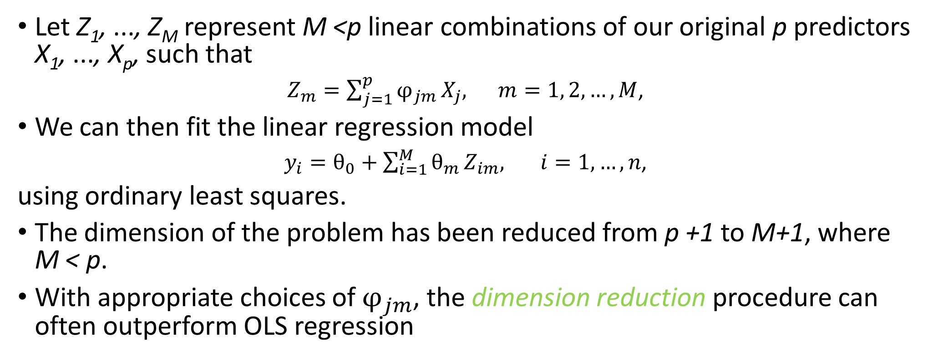
Dimension reduction methods
Let Z₁, ..., Z_{M} represent M <p linear combinations of our original p predictors X₁, ..., X_{p}, such that
$Z_{m}=\sum_{j=1}^{p}{φ_{jm}}X_{j}, m=1, 2, …, M$,
We can then fit the linear regression model
$y_{i}=θ_{0}+\sum_{i=1}^{M}{θ_{m}}Z_{im}, i=1,…,n$,
using ordinary least squares.
The dimension of the problem has been reduced from p +1 to M+1, where M < p.
With appropriate choices of $φ_{jm}$, the dimension reduction procedure can often outperform OLS regression

Slide 44
Principal components regression (PCR)
We apply principal components analysis (PCA) (Chapter 3) to define the linear combinations of the predictors, for use in our regression.
The first principal component (PC) is the (normalized) linear combination of the variables with the largest variance.
The second PC has the second largest variance and is uncorrelated with the first.
And so on.
Hence with many correlated original variables, we replace them with a small set of uncorrelated PCs that capture their joint variation.

Slide 45
Application to PCR
The PCR approach involves constructing the first M <p PCs, Z₁, ..., Z_{M} , and then using these components as the predictors in a linear regression model that is fit using least squares.
If the assumption underlying PCR holds, by estimating only M <p coefficients we can mitigate overfitting.
When performing PCR, we generally recommend standardizing each predictor prior to generating the PCs. This standardization ensures that all variables are on the same scale.
Remark: we choose M by using cross-validation

Slide 46
Potential problems of PCR
PCR is an unsupervised procedure for dealing with problems with inherently highly correlated predictors or problems with more predictors than observations (i.e., n < p)
New predictors produced by PCA may not explain the response, since PCA only summarizes this relationship of the predictors using the direction of maximal variability of the predictors.
In other words, PCA does not consider any aspects of the response when it selects its components for new predictors.

Slide 47
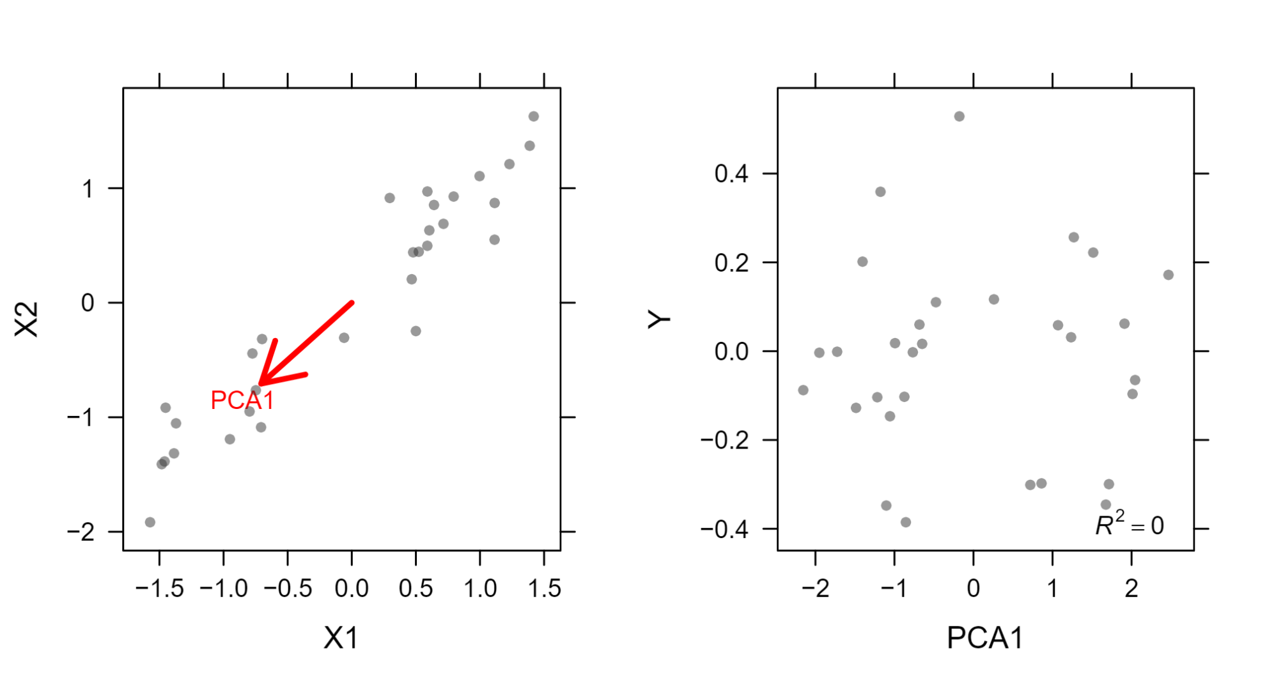
Example
Left: A scatter plot of the two predictors shows the direction of the ﬁrst principal component. Right: The ﬁrst PCA direction contains no predictive information for the response.

Slide 48
Partial least squares (PLS)
PCR identifies PCs in an unsupervised way, since the response Y is not used to help determine the PC directions.
PCR suffers from a drawback: there is no guarantee that the directions that best explain the predictors will also be the best directions to use for predicting the response.
PLS is a supervised alternative to PCR. It makes use of Y in order to identify new features that not only approximate the old features well, but also that are related to the response.
Roughly speaking, the PLS approach attempts to find the new features Z₁, ..., Z_{M} that help explain both Y and X.

Slide 49
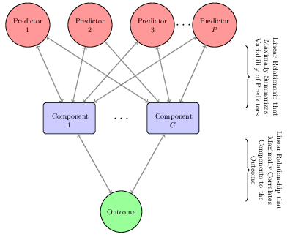
A diagram depicting the structure of a PLS model

Slide 50
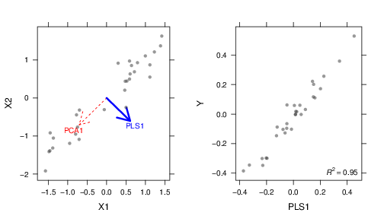
Example (cont’s)
Left: The ﬁrst PLS direction is nearly orthogonal to the ﬁrst PCA direction. Right: Unlike PCA, the PLS direction contains highly predictive information for the response.

Slide 51
PCR vs. PLS
As with PCR, M is typically chosen by cross-validation.
We generally standardize the predictors and response before performing PLS.
PLS is popular in the field of chemometrics, where many variables arise from digitized spectrometry signals.
In practice it often performs no better than PCR.

Slide 52
Model building
Shrinkage-Penalized models

Slide 53
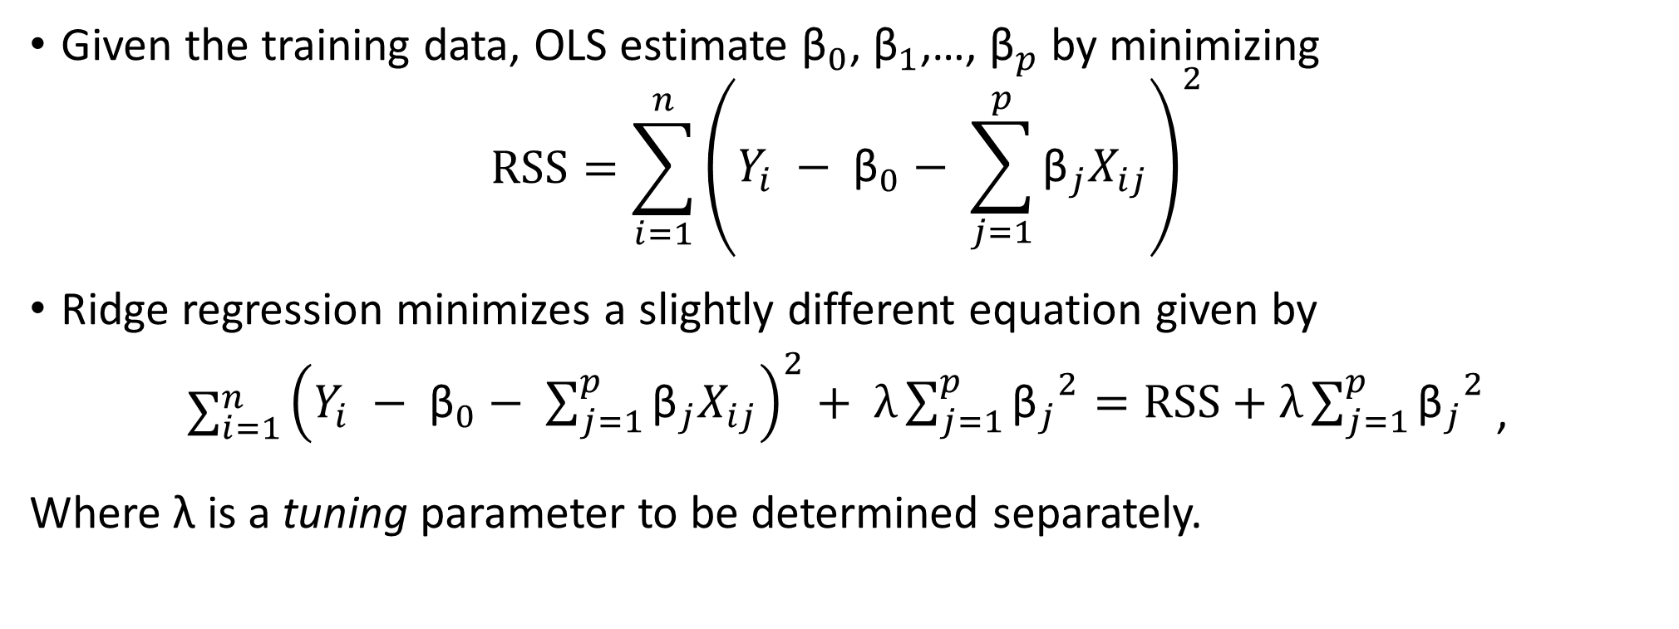
Ridge regression
Given the training data, OLS estimate ${\text{β}}_{0}$, ${\text{β}}_{1}$,…, ${\text{β}}_{p}$ by minimizing
$$RSS=\sum_{i=1}^{n}{\begin{aligned}{\left(Y_{i} − {\text{β}}_{0}− \sum_{j=1}^{p}{{\text{β}}_{j}X_{ij}}\right)}^{2} \\ \end{aligned}}$$
Ridge regression minimizes a slightly different equation given by
$\sum_{i=1}^{n}{\begin{aligned}{\left(Y_{i} − {\text{β}}_{0}− \sum_{j=1}^{p}{{\text{β}}_{j}X_{ij}}\right)}^{2}+ λ\sum_{j=1}^{p}{{{\text{β}}_{j}}^{2}=RSS+λ\sum_{j=1}^{p}{{{\text{β}}_{j}}^{2}}} \\ \end{aligned}}$ ,
Where λ is a tuning parameter to be determined separately.

Slide 54
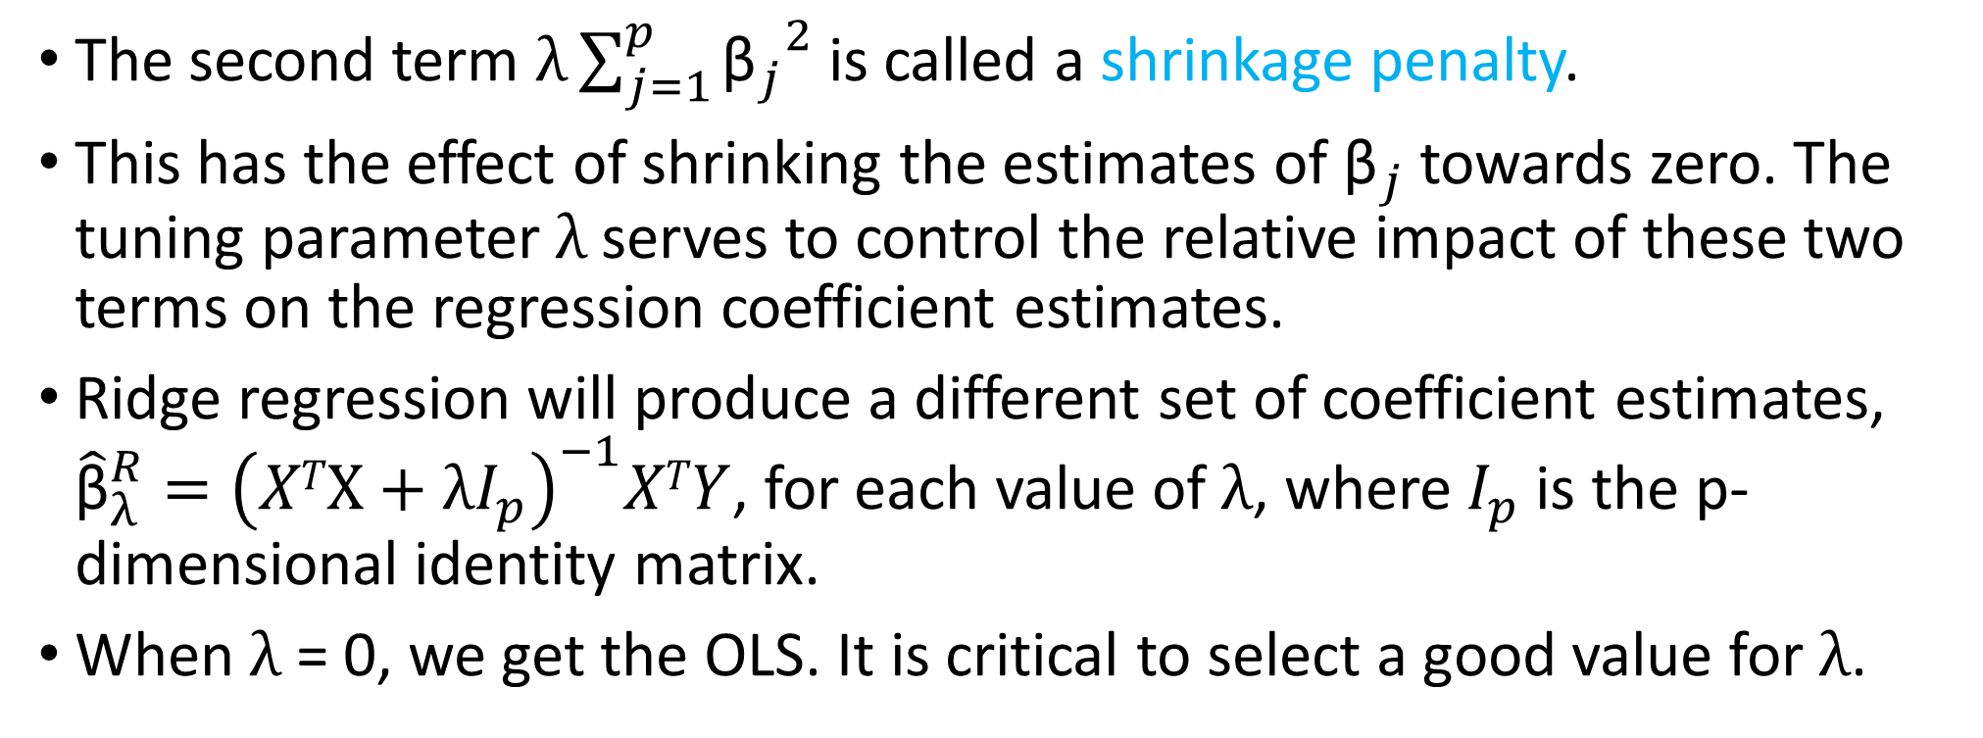
Ridge regression
The second term $λ\sum_{j=1}^{p}{{{\text{β}}_{j}}^{2}}$ is called a shrinkage penalty.
This has the effect of shrinking the estimates of ${\text{β}}_{j}$ towards zero. The tuning parameter $λ$serves to control the relative impact of these two terms on the regression coefficient estimates.
Ridge regression will produce a different set of coefficient estimates, ${\hat{\text{β}}}_{λ}^{R}={\left(XT\text{X}+λI_{p}\right)}^{−1}XTY$, for each value of $λ$, where $I_{p}$ is the p-dimensional identity matrix.
When $λ$ = 0, we get the OLS. It is critical to select a good value for $λ$.

Slide 55
Cross-validation for λ

Slide 56
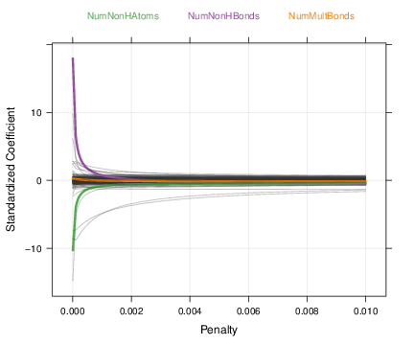
Ridge regression for solubility data

Slide 57
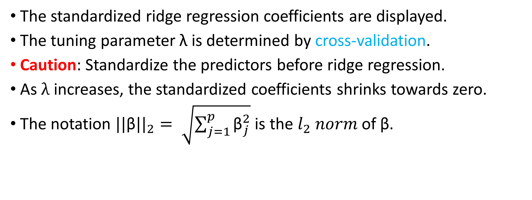
Ridge regression for solubility data
The standardized ridge regression coefficients are displayed.
The tuning parameter λ is determined by cross-validation.
Caution: Standardize the predictors before ridge regression.
As $λ$ increases, the standardized coefficients shrinks towards zero.
The notation ${||\text{β}||}_{2}= \sqrt{\sum_{j=1}^{p}{{\text{β}}_{j}^{2}}}$ is the $l_{2} norm$ of $\text{β}$.

Slide 58
Ridge regression vs. OLS
In general, the ridge regression estimates will be more biased than the OLS ones but have lower variance.
Ridge regression will work best in situations where the OLS estimates have high variance. Such situations include p ≈ n, p > n, multicollinearity, etc.
Ridge regression also has substantial computational advantages over best subset selection: for any given λ, we only need to fit one model and the computations turn out to be very simple

Slide 59
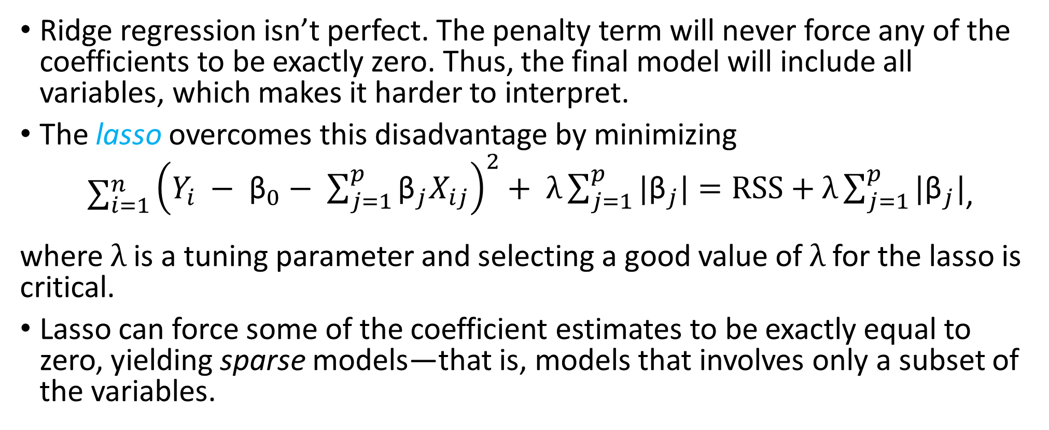
The Lasso
Ridge regression isn’t perfect. The penalty term will never force any of the coefficients to be exactly zero. Thus, the final model will include all variables, which makes it harder to interpret.
The lasso overcomes this disadvantage by minimizing
$\sum_{i=1}^{n}{\begin{aligned}{\left(Y_{i} − {\text{β}}_{0}− \sum_{j=1}^{p}{{\text{β}}_{j}X_{ij}}\right)}^{2}+ λ\sum_{j=1}^{p}{|{\text{β}}_{j}|=RSS+λ\sum_{j=1}^{p}{|{\text{β}}_{j}|}} \\ \end{aligned}}$,
where $λ$is a tuning parameter and selecting a good value of $λ$for the lasso is critical.
Lasso can force some of the coefficient estimates to be exactly equal to zero, yielding sparse models—that is, models that involves only a subset of the variables.

Slide 60
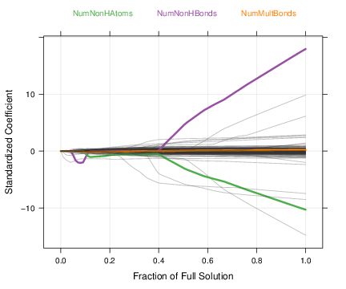
Lasso regression for solubility data

Slide 61
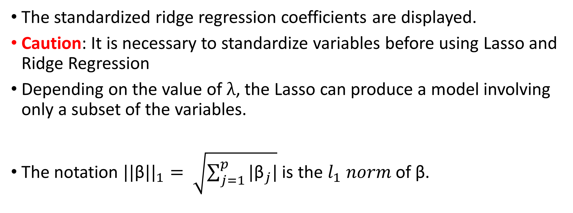
Ridge regression for solubility data
The standardized ridge regression coefficients are displayed.
Caution: It is necessary to standardize variables before using Lasso and Ridge Regression
Depending on the value of $λ$, the Lasso can produce a model involving only a subset of the variables.
The notation ${||\text{β}||}_{1}= \sqrt{\sum_{j=1}^{p}{|{\text{β}}_{j}|}}$ is the $l_{1} norm$ of $\text{β}$.
Variable Selection

Slide 62
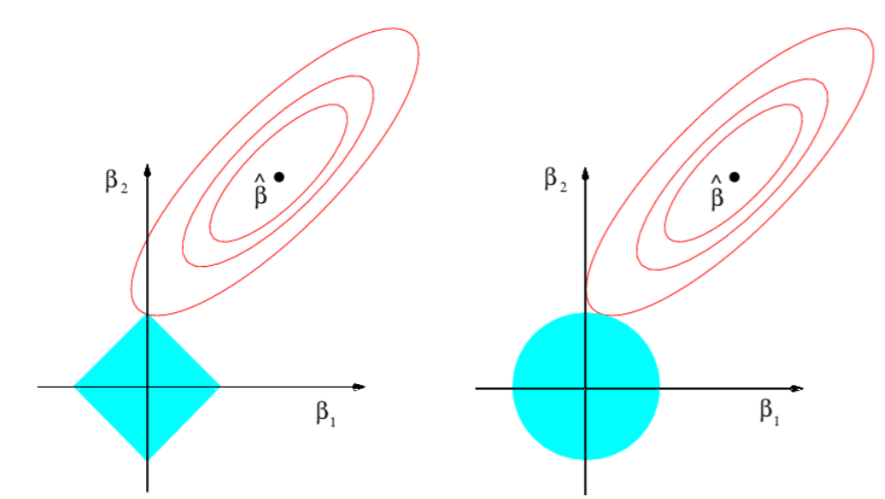
Why can lasso do variable selection?
Contours of the error and constraint functions for the lasso(left) and ridge regression (right)

Slide 63
Lasso vs. ridge regression
Neither ridge regression nor the lasso will universally dominate the other.
The lasso tends to perform better in a setting where a relatively small number of predictors have substantial coefficients.
Ridge regression will perform better when the response is a function of many predictors, all with coefficients of roughly equal size.
However, the number of predictors that is related to the response is never known a priori for real data sets. A technique such as cross-validation can be used to determine which approach is better on a particular data set.
Unlike ridge regression, the lasso performs variable selection, resulting in models that are easier to interpret

Slide 64
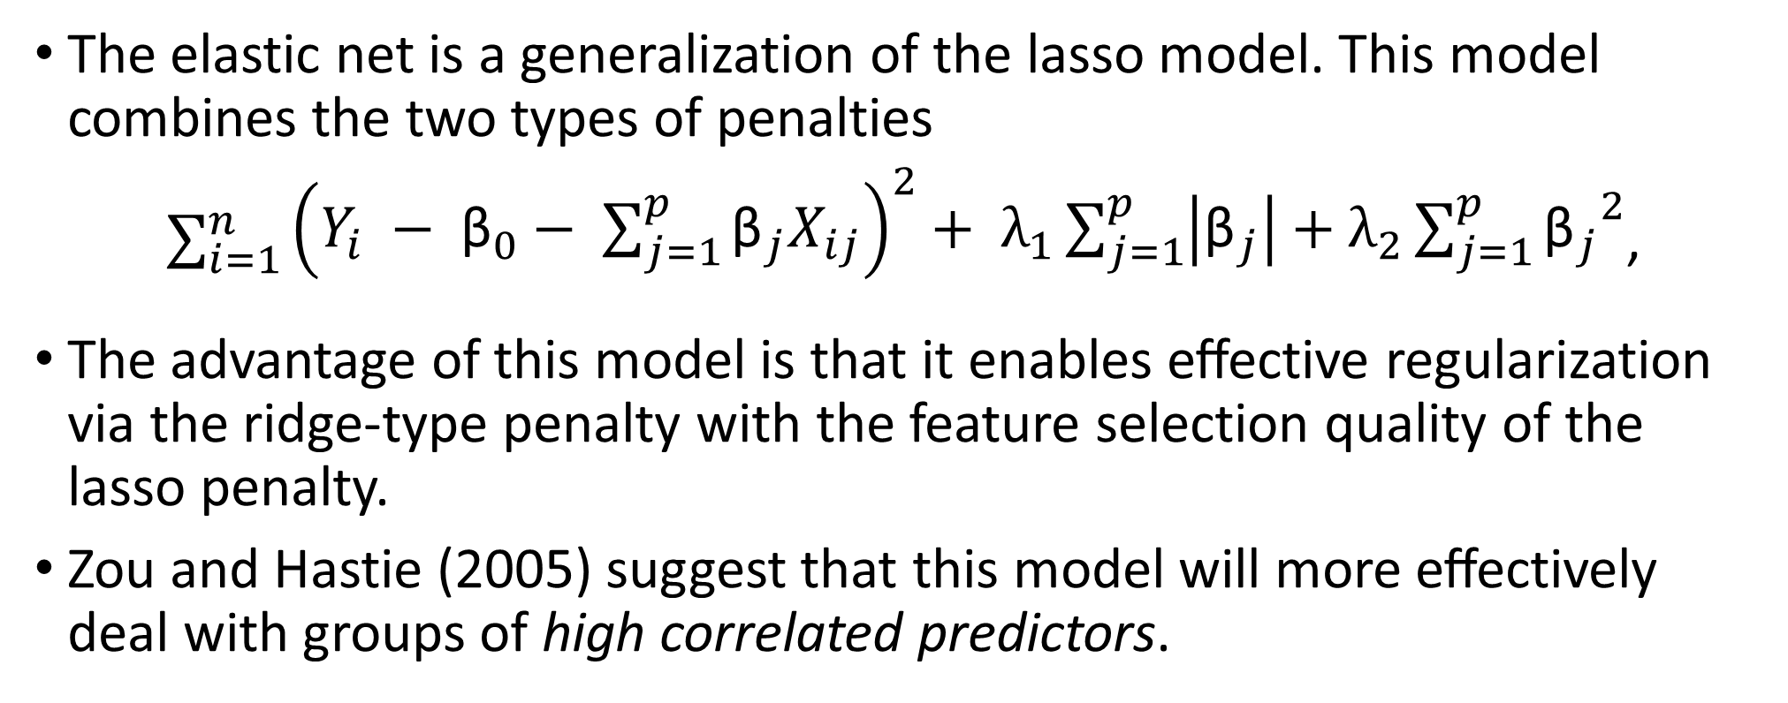
Elastic net
The elastic net is a generalization of the lasso model. This model combines the two types of penalties
$\sum_{i=1}^{n}{\begin{aligned}{\left(Y_{i} − {\text{β}}_{0}− \sum_{j=1}^{p}{{\text{β}}_{j}X_{ij}}\right)}^{2}+ λ_{1}\sum_{j=1}^{p}{\left|{\text{β}}_{j}\right|+λ_{2}\sum_{j=1}^{p}{{{\text{β}}_{j}}^{2}}} \\ \end{aligned}}$,
The advantage of this model is that it enables eﬀective regularization via the ridge-type penalty with the feature selection quality of the lasso penalty.
Zou and Hastie (2005) suggest that this model will more eﬀectively deal with groups of high correlated predictors.

Slide 65
R demonstrations for solubility data
Linear regression model
Principal component regression(PCR)
Partial least squares (PLS)
Penalized regression models
Ridge regression
Elastic net (ENET)

Slide 66
Call required packages and access the data
#Required packages library(AppliedPredictiveModeling) library(lattice) library(caret) library(corrplot) library(e1071) library(pls) library(elasticnet) #Access the solubility data data(solubility) #This data contain traing data str(solTrainY) dim(solTrainX) ##Test data head(solTestY) head(solTestX)

Slide 67
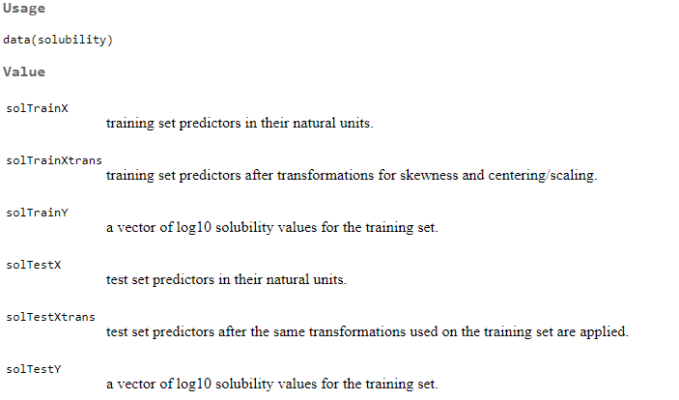
Data Information
http://127.0.0.1:27533/library/AppliedPredictiveModeling/html/solubility.html

Slide 68
Create a control function
### Create a control function that will be used across models. We ### create the fold assignments explicitly instead of relying on the ### random number seed being set to identical values. set.seed(100) #Create a series of test/training partitions #default is 10, the funtion below creates 10 folder indx <- createFolds(solTrainY, returnTrain = TRUE) #control the computational nuances of the train function ctrl <- trainControl(method = "cv", index = indx)

Slide 69
R demonstrations for solubility data
Linear regression model

Slide 70
Linear regression
### Linear regression model with all of the predictors. This will ### produce some warnings that a 'rank-deficient fit may be ### misleading'. This is related to the predictors being so highly ### correlated that some of the math has broken down. set.seed(100) lmTune0 <- train(x = solTrainXtrans, y = solTrainY, method = "lm", trControl = ctrl) lmTune0 summary(lmTune0) #provide regression coefficients ### Save the test set results in a data frame testResults <- data.frame(obs = solTestY, Linear_Regression = predict(lmTune0, solTestXtrans))

Slide 71
Linear regression
> lmTune0 Linear Regression 951 samples 228 predictors No pre-processing Resampling: Cross-Validated (10 fold) Summary of sample sizes: 856, 855, 857, 856, 856, 855, ... Resampling results: RMSE Rsquared MAE 0.7170016 0.8792751 0.5298775 Tuning parameter 'intercept' was held constant at a value of TRUE

Slide 72
Linear regression with data preprocessing
### And another using a set of predictors reduced by unsupervised ### filtering. We apply a filter to reduce extreme between-predictor ### correlations. Note the lack of warnings. tooHigh <- findCorrelation(cor(solTrainXtrans), .9) trainXfiltered <- solTrainXtrans[, -tooHigh] testXfiltered <- solTestXtrans[, -tooHigh] set.seed(100) lmTune <- train(x = trainXfiltered, y = solTrainY, method = "lm", trControl = ctrl) lmTune

Slide 73
R demonstrations for solubility data
Partial Least Squares (PLS) & Principal component regression (PCR)

Slide 74
Partial Least Squares (PLS)
## Run PLS and PCR on solubility data and compare results #library(pls) set.seed(100) plsTune <- train(x = solTrainXtrans, y = solTrainY, method = "pls", tuneGrid = expand.grid(ncomp = 1:50), trControl = ctrl) plsTune plot(plsTune) #prediction for test data testResults$PLS <- predict(plsTune, solTestXtrans)

Slide 75
PLS
> plsTune Partial Least Squares 951 samples 228 predictors No pre-processing Resampling: Cross-Validated (10 fold) Summary of sample sizes: 856, 855, 857, 856, 856, 855, ... Resampling results across tuning parameters: ncomp RMSE Rsquared MAE 1 1.7567200 0.2656794 1.4372895 2 1.2744189 0.6113687 0.9891602 … … 49 0.7328515 0.8734481 0.5423624 50 0.7333185 0.8731901 0.5434880 RMSE was used to select the optimal model using the smallest value. The final value used for the model was ncomp = 17.

Slide 76
Plot of tuning parameter for PLS

Slide 77
Principal component regression (PCR)
set.seed(100) pcrTune <- train(x = solTrainXtrans, y = solTrainY, method = "pcr", tuneGrid = expand.grid(ncomp = 1:35), trControl = ctrl) pcrTune

Slide 78
PCR
> pcrTune Principal Component Analysis 951 samples 228 predictors No pre-processing Resampling: Cross-Validated (10 fold) Summary of sample sizes: 856, 855, 857, 856, 856, 855, ... Resampling results across tuning parameters: ncomp RMSE Rsquared MAE 1 1.9823303 0.07290019 1.5869212 … … 49 0.7213154 0.87550719 0.5539427 50 0.7223208 0.87520400 0.5543803 RMSE was used to select the optimal model using the smallest value. The final value used for the model was ncomp = 49.

Slide 79
Plot of tuning parameter for PCR

Slide 80
Plots of two tuning parameters
plsResamples <- plsTune$results plsResamples$Model <- "PLS" pcrResamples <- pcrTune$results pcrResamples$Model <- "PCR" plsPlotData <- rbind(plsResamples, pcrResamples) xyplot(RMSE ~ ncomp, data = plsPlotData, #aspect = 1, xlab = "# Components", ylab = "RMSE (Cross-Validation)", auto.key = list(columns = 2), groups = Model, type = c("o", "g"))

Slide 81
Plots of two tuning parameters

Slide 82
Predictor importance for the PLS models
#Predictor importance plot for PLS model plsImp <- varImp(plsTune, scale = FALSE) plot(plsImp, top = 25, scales = list(y = list(cex = .95)))

Slide 83
Predictor importance for the PLS models
#Predictor importance plot for PCR model pcrImp <- varImp(pcrTune, scale = FALSE) plot(pcrImp, top = 25, scales = list(y = list(cex = .95)))

Slide 84
R demonstrations for solubility data
Ridge regression

Slide 85
Ridge regression
## The text used the elasticnet to obtain a ridge regression model. ## There is now a simple ridge regression method. #you may need to try different ranges of values for lambda ridgeGrid <- expand.grid(lambda = seq(0, .1, length = 10)) ### Start the clock to track time! ptm <- proc.time() set.seed(100) #it may take a while to get results #library(elasticnet) ridgeTune <- train(x = solTrainXtrans, y = solTrainY, method = "ridge", tuneGrid = ridgeGrid, trControl = ctrl, preProc = c("center", "scale")) proc.time() - ptm ### Stop the clock

Slide 86
Ridge regression
ridgeTune #check the names of output in ridgeTune names(ridgeTune) summary(ridgeTune) #plot the tuning parameter lambda plot(ridgeTune, xlab = "Penalty")

Slide 87
Ridge regression
> ridgeTune Ridge Regression 951 samples 228 predictors Pre-processing: centered (228), scaled (228) Resampling: Cross-Validated (10 fold) Summary of sample sizes: 856, 855, 857, 856, 856, 855, ... Resampling results across tuning parameters: lambda RMSE Rsquared MAE 0.00000000 0.7169416 0.8793300 0.5298092 0.01111111 0.6913735 0.8869082 0.5232301 0.02222222 0.6860086 0.8887434 0.5217135 … 0.10000000 0.7116491 0.8846838 0.5480085 RMSE was used to select the optimal model using the smallest value. The final value used for the model was lambda = 0.02222222. >

Slide 88
Ridge regression

Slide 89
The ENET regression
### ENET ptm <- proc.time() enetGrid <- expand.grid(lambda = c(0, 0.01, .1), fraction = seq(.05, 1, length = 20)) set.seed(100) enetTune <- train(x = solTrainXtrans, y = solTrainY, method = "enet", tuneGrid = enetGrid, trControl = ctrl, preProc = c("center", "scale")) proc.time() - ptm ### Stop the clock #> proc.time() – ptm #time may change # user system elapsed # 34.31 0.48 34.89

Slide 90
The ENET regression
enetTune names(enetTune) #plot the regession coefficients matplot(enetTune$finalModel$beta.pure, type='l') #Or matplot(predict(enetTune$finalModel,type="coef")$coefficients, type='l') plot(enetTune)

Slide 91
The ENET regression
> enetTune Elasticnet 951 samples 228 predictors Pre-processing: centered (228), scaled (228) Resampling: Cross-Validated (10 fold) Summary of sample sizes: 856, 855, 857, 856, 856, 855, ... Resampling results across tuning parameters: lambda fraction RMSE Rsquared MAE 0.00 0.05 0.8682135 0.8364159 0.6582205 0.00 0.10 0.6917546 0.8861422 0.5272791 0.00 0.15 0.6784548 0.8902877 0.5179525 … 0.10 1.00 0.7116491 0.8846838 0.5480085 RMSE was used to select the optimal model using the smallest value. The final values used for the model were fraction = 0.6 and lambda = 0.01. >

Slide 92
The ENET regression

Slide 93
R demonstrations for solubility data
Which model has the best predictive ability?

Slide 94
Model comparisons
### create empty spaces to save the values of R2 and RMSE R2 <-RMSE<-MAE<- numeric(0) #Linear regression model testResults$LRM<- predict(lmTune0, solTestXtrans) R2[1] = cor(testResults$LRM, solTestY)^2 RMSE[1] = sqrt(mean((testResults$LRM - solTestY)^2)) MAE[1] = mean(abs(testResults$LRM - solTestY)) #PCR testResults$PCR <- predict(pcrTune, solTestXtrans) R2[2] = cor(testResults$PCR, solTestY)^2 RMSE[2] = sqrt(mean((testResults$PCR - solTestY)^2)) MAE[2] = mean(abs(testResults$PCR - solTestY)) #PLS testResults$PLS <- predict(plsTune, solTestXtrans) R2[3] = cor(testResults$PLS, solTestY)^2 RMSE[3] = sqrt(mean((testResults$PLS - solTestY)^2)) MAE[3] = mean(abs(testResults$PLS - solTestY))

Slide 95
Which model has the best predictive ability?
#Ridge regression testResults$Ridge <- predict(ridgeTune, solTestXtrans) R2[4] = cor(testResults$Ridge, solTestY)^2 RMSE[4] = sqrt(mean((testResults$Ridge - solTestY)^2)) MAE[4] = mean(abs(testResults$Ridge - solTestY)) #ENET regression testResults$ENET <- predict(enetTune, solTestXtrans) R2[5] = cor(testResults$ENET, solTestY)^2 RMSE[5] = sqrt(mean((testResults$ENET - solTestY)^2)) MAE[5] = mean(abs(testResults$ENET - solTestY)) results = cbind(R2, RMSE, MAE) row.names(results) = c("LRM", "PCR", "PLS", "Ridge", "ENET") results

Slide 96
Model comparison results
> results R2 RMSE MAE LRM 0.8722236 0.7455802 0.5497605 PCR 0.8551094 0.7920149 0.6030362 PLS 0.8805903 0.7192161 0.5401932 Ridge 0.8801309 0.7215616 0.5369285 ENET 0.8841315 0.7072226 0.5300267

Slide 97
> results R2 RMSE MAE LRM 0.8722236 0.7455802 0.5497605 PCR 0.8551094 0.7920149 0.6030362 PLS 0.8805903 0.7192161 0.5401932 Ridge 0.8801309 0.7215616 0.5369285 ENET 0.8841315 0.7072226 0.5300267
Who is the winner?

Slide 98

Introduction to R
Exercise 3

